Slide 1
Minor Project
Under the Guidance of:
Prof. Yograj Sharma
Members :
Tanmay Pathak
Rohit Kumar Rajput
Mayank Jain
CSE 3rd Year

Slide 2

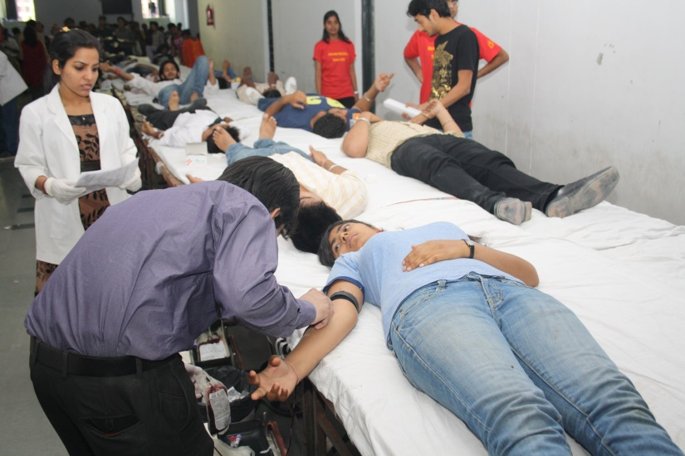
Idea...
Donors
Blood Donation Camps

Slide 3

ShareLife

Slide 4

About..
ShareLife is a Web Application, which gives the platform to the charitable organization in order to share the information of blood donation camps to the donors.
ShareLife facilitate the donors to get information about the blood donation camps organized by the charitable organization on their Gmail account.

Slide 5

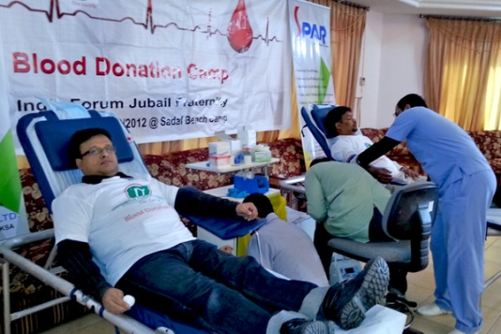

How It Works..
Register
ShareLife
Donor’s
Register
Search
Notification
Charitable Organization

Slide 6
Features..
Gmail Notification to Registered Blood Donors about Blood Camps held in their City.
Donor’s Registrations with Gmail OTP.
Charitable Organization Registration Gmail OTP.
Blood Donation Camps registration by the Organization.
Donors can view the Details of Charitable Organization organizing Blood Donation Camps.
Organization can view the Metadata about the Blood Donors.

Slide 7

Requirements..
Google’s SMTP server for Gmail Notification.
Java Server Page (FrontEnd)
Java Servlet (BackEnd)
MySQL (Database)

Slide 8
Conclusion..
Share life is a new and innovative web application feature which will provide timely opportunities to the enthusiastic blood donors.
On the other hand it will be beneficial to the organizations if the no. Of donors increases .
It will also serves as the main hub for the organisations in the future times for their upcomig events

Slide 9
Thank You…

